Slide 1










Airbnb Listings Data
Presented By:
Ramisa Hassan
CIS512: Intro to Data Science

Slide 2


Introduction
Dataset collected from ‘Open Data Portal’
The dataset contains information about Airbnb listings, hosts, and related attributes.
Includes details on property characteristics, host profiles, pricing, and guest reviews.
The data is diverse, with both categorical and numerical attributes.
Primary goal is to thoroughly assess the feasibility and profitability of investing in Airbnb within select cities, with a specific focus on the United Kingdom and European Countries .
Page 02

Slide 3
Overview of the Dataset
Host
Location
Accommodation Information
Host ID
Host Response Time
Host Response Rate
Host Acceptance Rate
Host Total Listings Count
Experiences Offered
Country
City
State
Zip code
Latitude
Longitude
Neighbourhood
Property Type
Room Type
Bed Type
Beds
Bathrooms
Reservation Status and Guest Feedback
Guest Amenities & Experiences:
Initially
Attribute : 89
Records: 494954
Availability
Review Scores
Cancelation Policy
Reviews per Month
Guests Included
Maximum & Minimum Nights
Extra People
Amenities: internet, TV, Kitchen, Kitchen, Heating, Washer
Features: Laptop Friendly Workspace, Smoke Detector, Instant Bookable
Page 03

Slide 4

Creating Separate Attibutes
TV, Internet
First Aid Kit
Kitchen
Amenities
Fire Extinguisher
Host Profile Pic
Is Location Exact
Heating, Washer
Breakfast, AC
Host is Superhost
Features
Instant Bookable
After Separating Records of Them
Attribute : 116
Records: 486996
Host ID Verified
Requires License
Page 04

Slide 5


Dropping of Columns
Access
Interaction
House Rules
Last Scraped
Picture URL
XL Picture URL
Square Feet
Features
Host URL
Host Picture URL
Host About
Host Location
Host Neighborhood
Geolocation
Jurisdiction Name
Calendar Updated
Neighborhood Group Cleansed
Host Verifications
Host Listings Count
Name
Summary
Space
Description
Notes
Transit
Smart Location
ID
Scrape ID
Neighborhood Overview
Listing URL
Country Code
Market
Monthly Price
Weekly Price
Amenities
After Dropping the Columns:
Attribute : 76
Records: 486996
Page 05

Slide 6

Overview of the Changes
Calculated in Months for how long they are operating
Dropped Rows containing Null Values
Host Since
Price
within an hour -> 1 Hour
within few hours -> Few Hours
within a day -> 1 Day
a few days or more -> Few Days
Replaced ‘0’ to United States.
Fill ‘Null’ values serially by checking the related information
Country
State
City
Street
Host Response Time
Assigned Null values to ‘Guesthouse’ and ‘Apartment’
Filled ‘Null’ with ‘1’
Beds & Bathrooms,
Minimum Nights
Property Type
Page 06

Slide 7
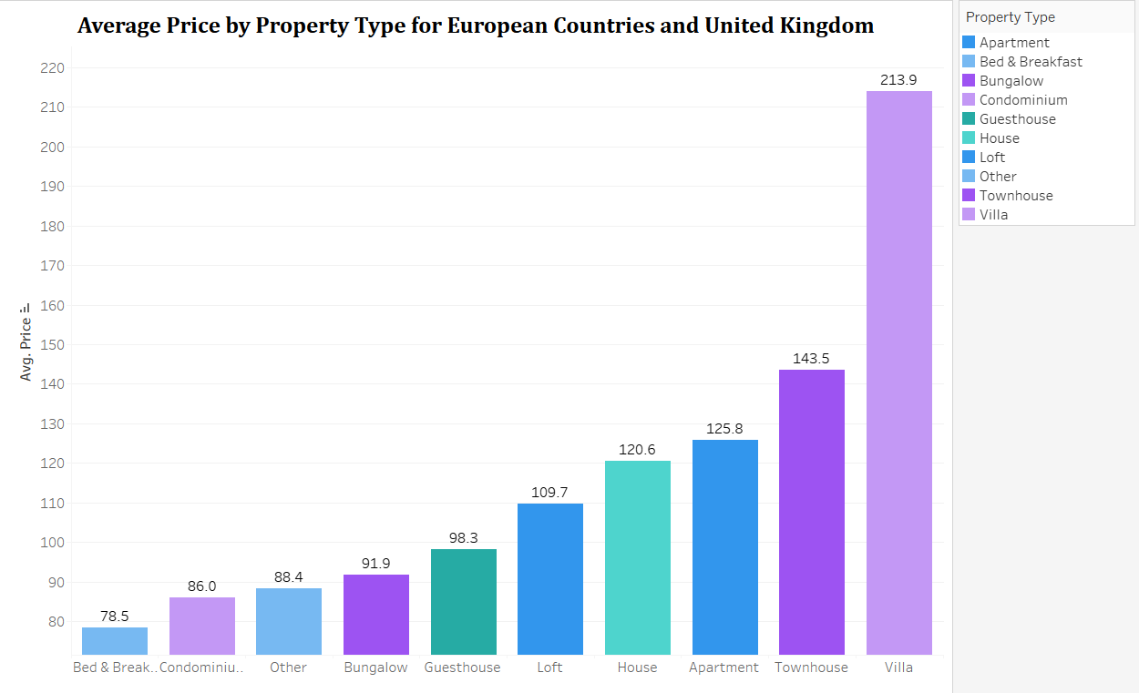
Average Price of the Properties
Page 07

Slide 8
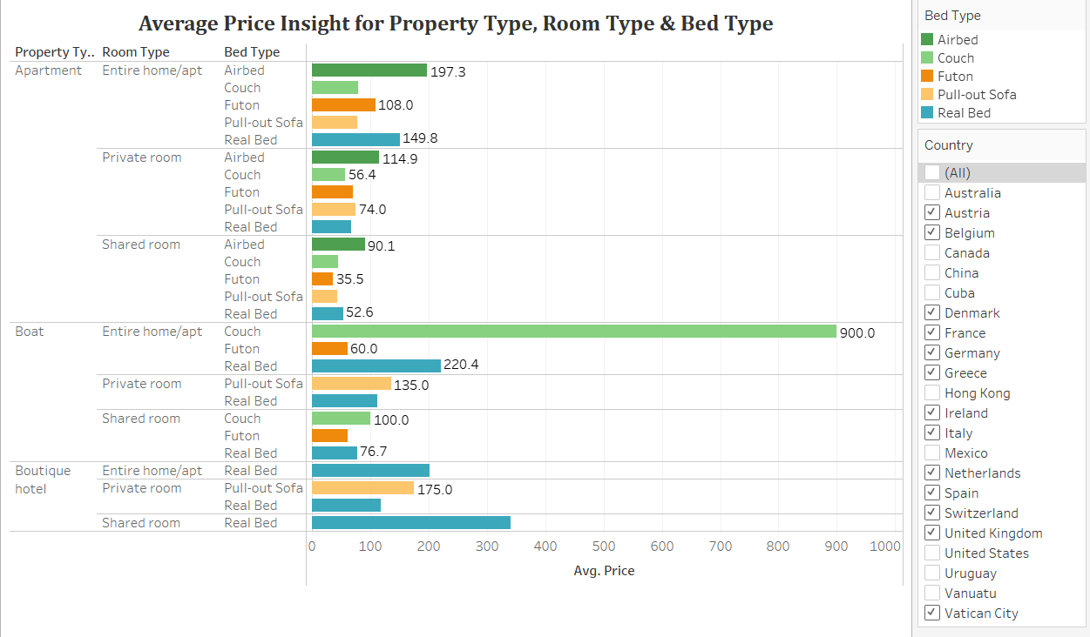
Bed, Property and Room Type Analysis: Average Pricing Insights
Page 08

Slide 9
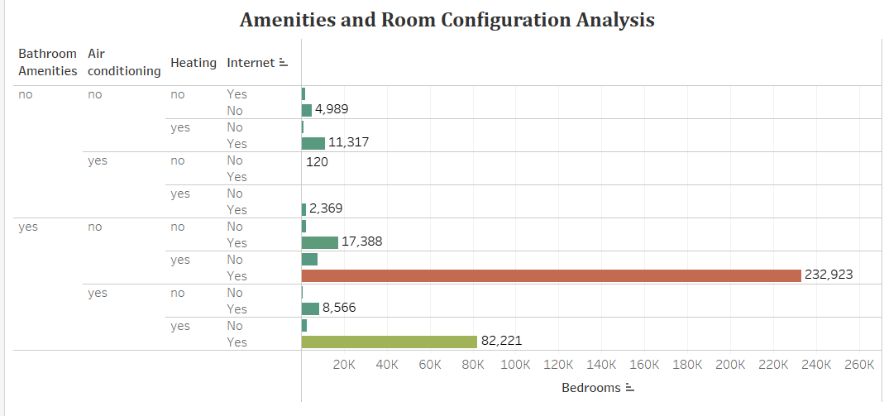
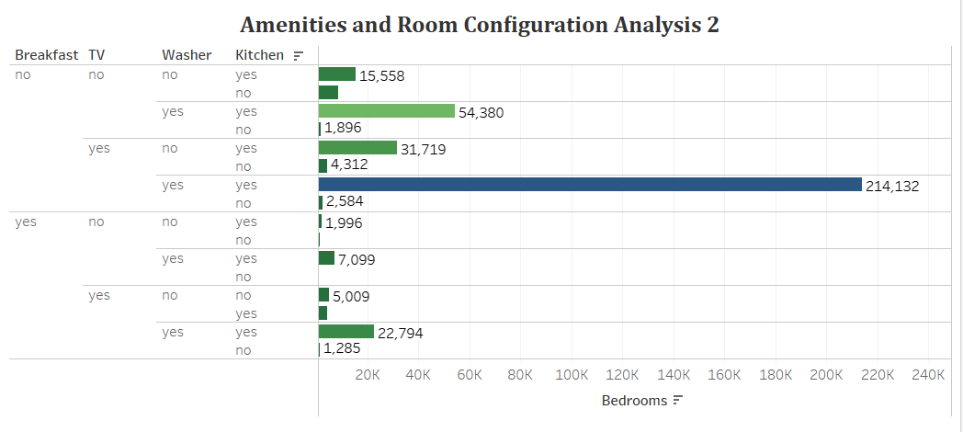
Impact of Amenities and Room Configuration
Page 09

Slide 10
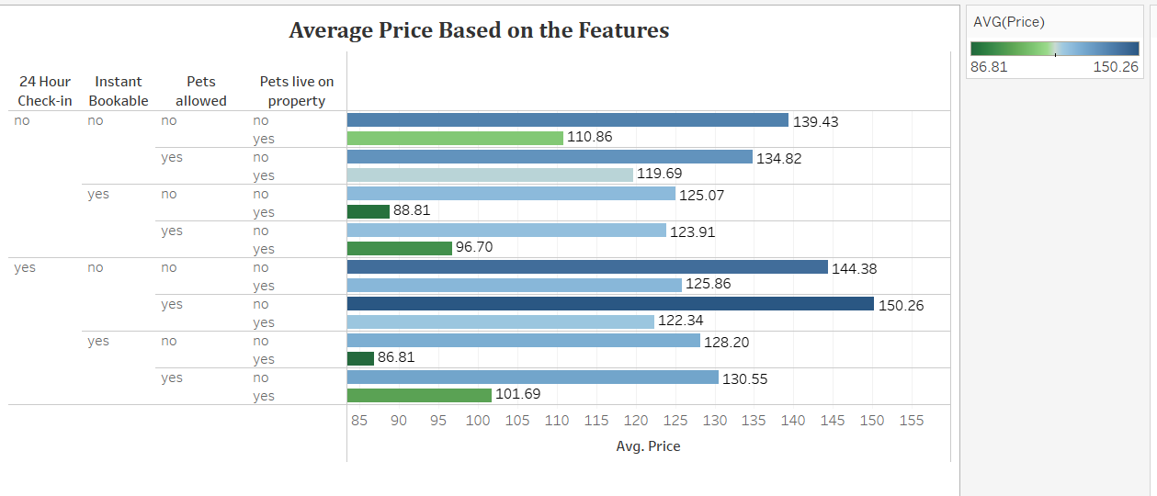
Influence of Hosting Features on Average Price
Page 10

Slide 11
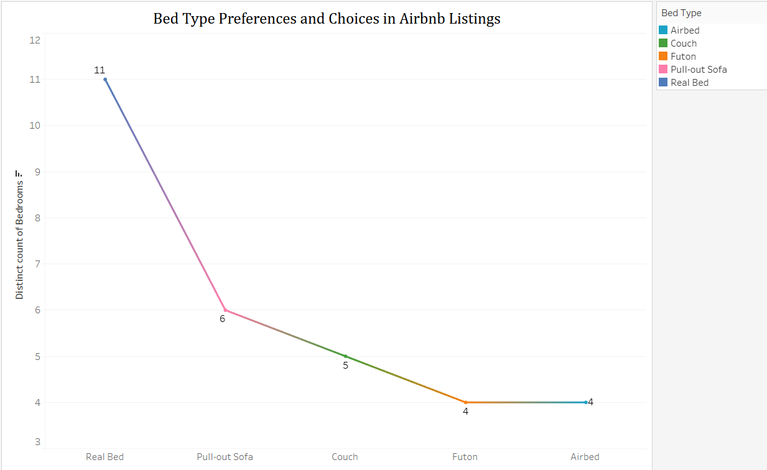
Bed Type Analysis
Page 11

Slide 12
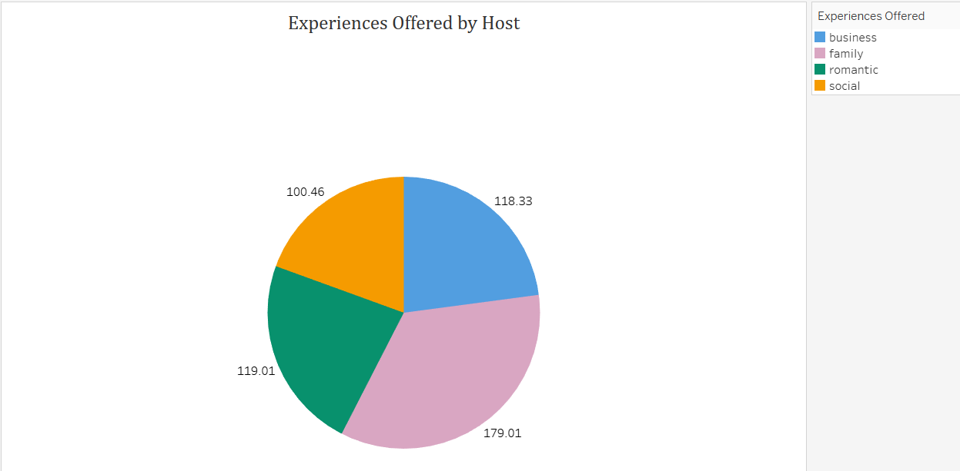
Guest Experience Analysis: Host Offerings and Average Price
Page 12

Slide 13
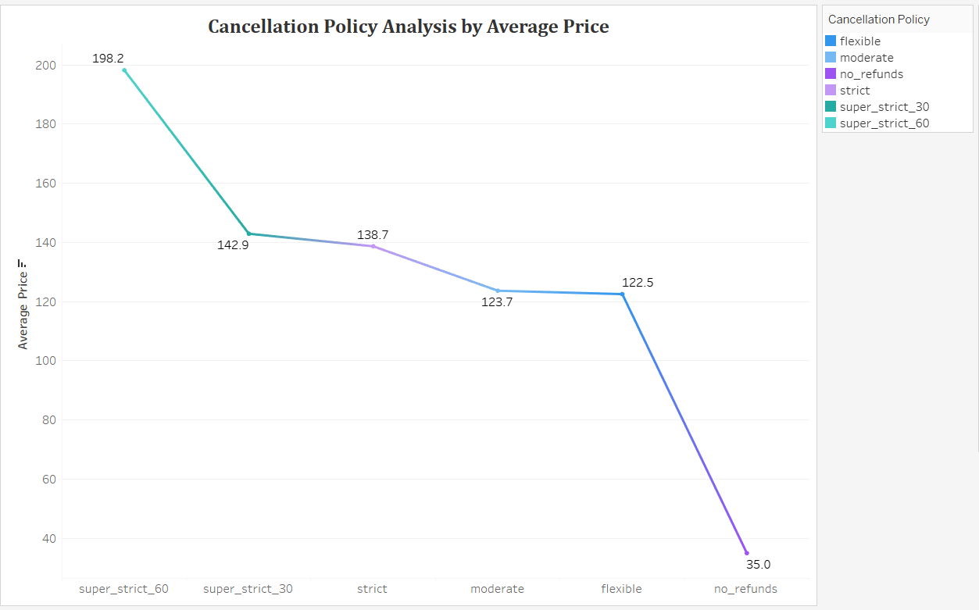
Cancellation Policy
Page 13

Slide 14
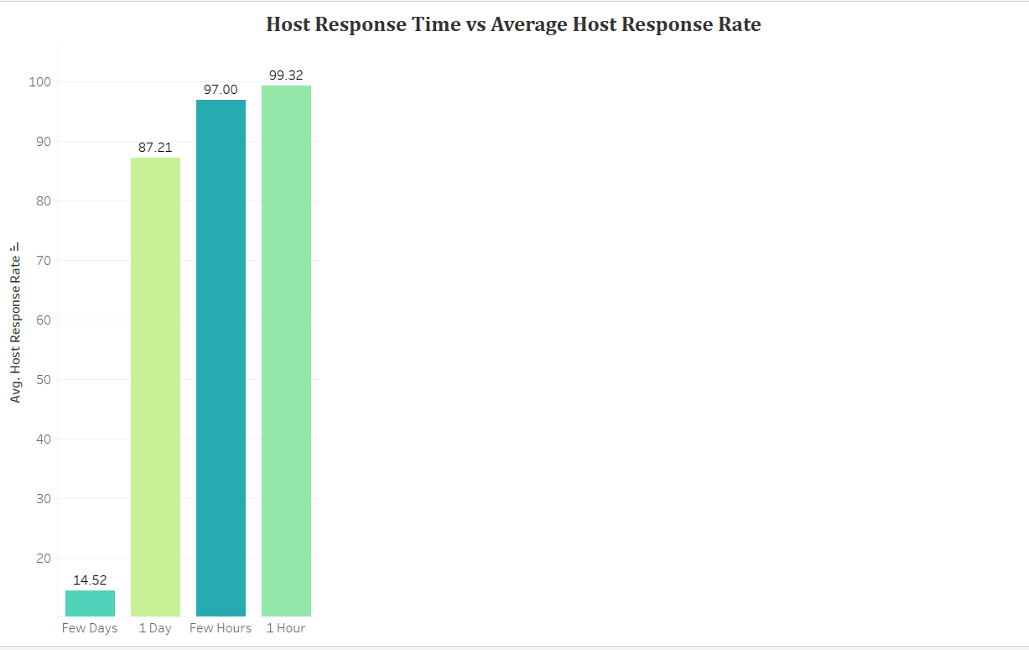
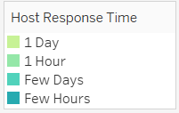




Analyzing Host Response Performance
Page 14

Slide 15

Host's Investment Takeaway
Takeaway 1
Takeaway 2
Takeaway 3
By focusing on providing the amenities and room configurations that align with the target audience, can enhance guest satisfaction, secure more bookings, and ultimately increase rental income. It's an approach that directly influences the return on investment and the long-term success of Airbnb venture.
The amenities that offered, such as room and bed types, breakfast options, TV, washer, and a well-equipped kitchen, are not just features; they are strategic tools to enhance guest satisfaction and attract more bookings.
The importance of a host's responsiveness in shaping the guest experience and, consequently, the length of stays. A swift and effective response to guest inquiries contributes to positive reviews, repeat bookings, and higher occupancy rates.
Page 15

Slide 16
Thank You

